Slide 1
Deep Residual Learning for Image Recognition
Presented by:
Jiaxing Liu
Prakriti Pandey

Slide 2
Content
Introduction
Deep Residual Learning
Implementation
Experiments
Conclusion

Slide 3
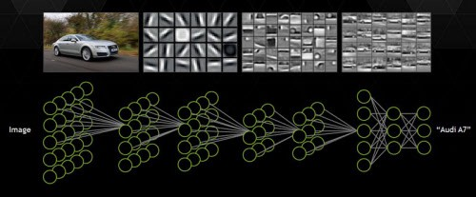
The deeper, the better

Slide 4
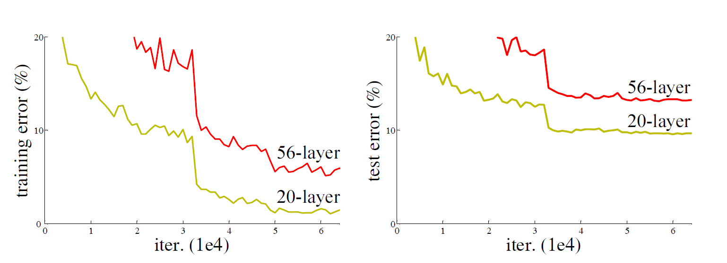
Degradation Problem

Slide 5
…
Degradation problem arises, as deeper network start converging.
As the network depth increases, accuracy gets saturated & degrades rapidly.

Slide 6
ResNet
Framework to train the deeper network.
Developed by Microsoft research team.
Proved the robustness in various visual recognition tasks and non visual tasks (speech & language)
Won 1st place on ILSVRC( ImageNet Large Scale Visual Recognition Challenge) & COCO in 2015.

Slide 7
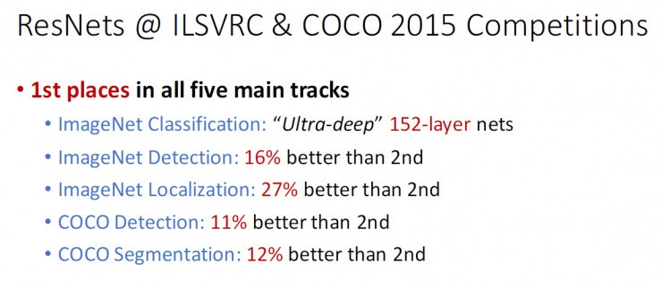

Slide 8
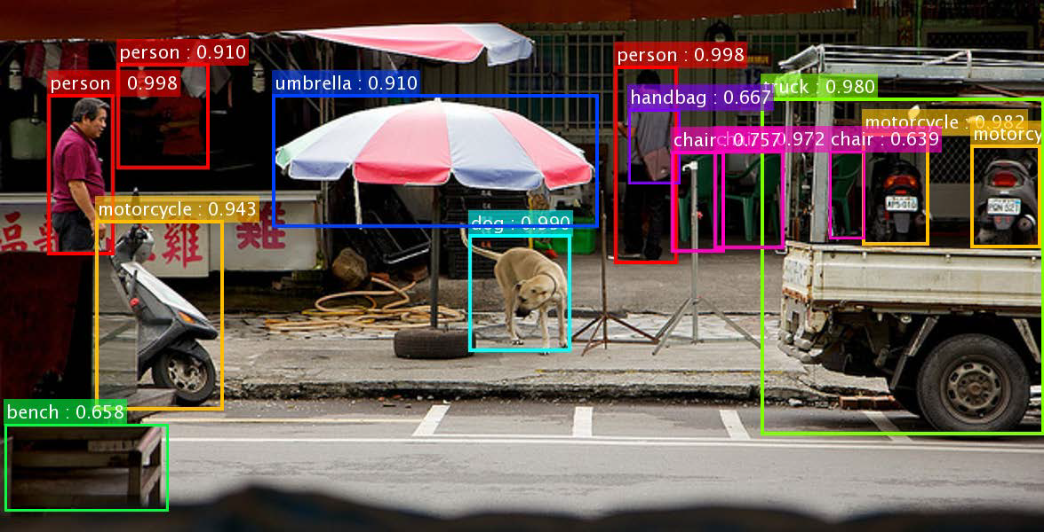
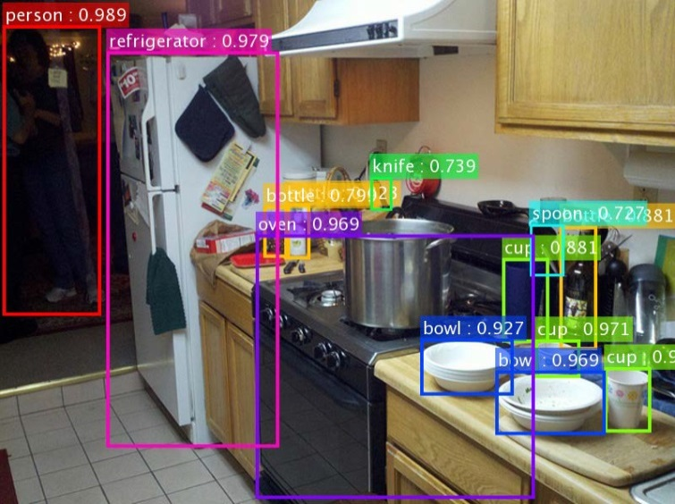
COCO detection
28% relative improvement

Slide 9
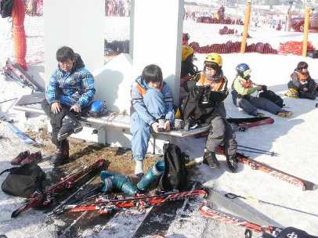
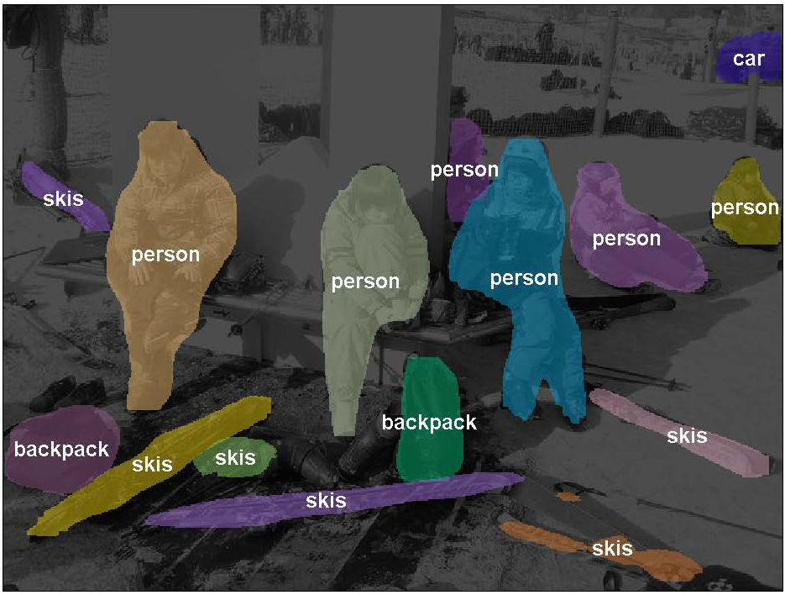
Segmentation

Slide 10
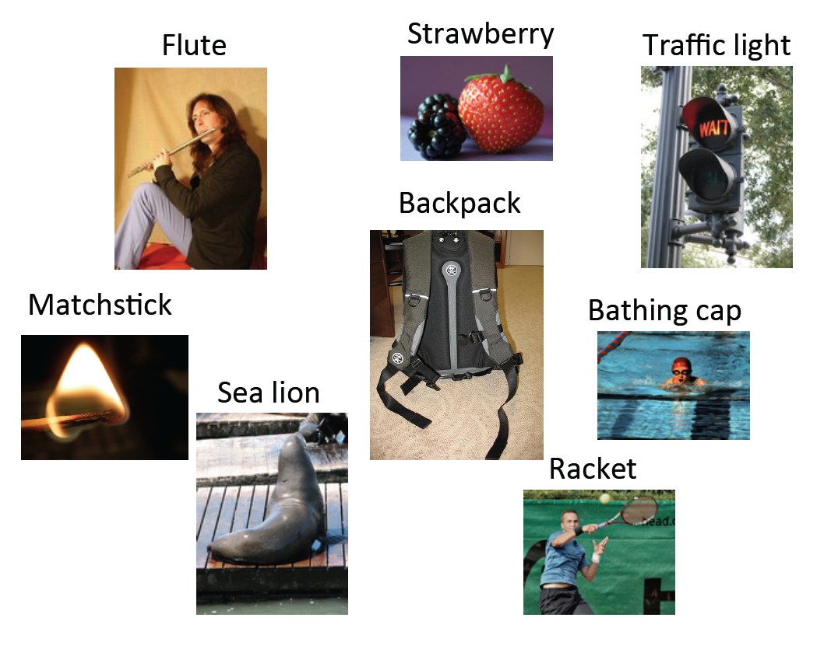
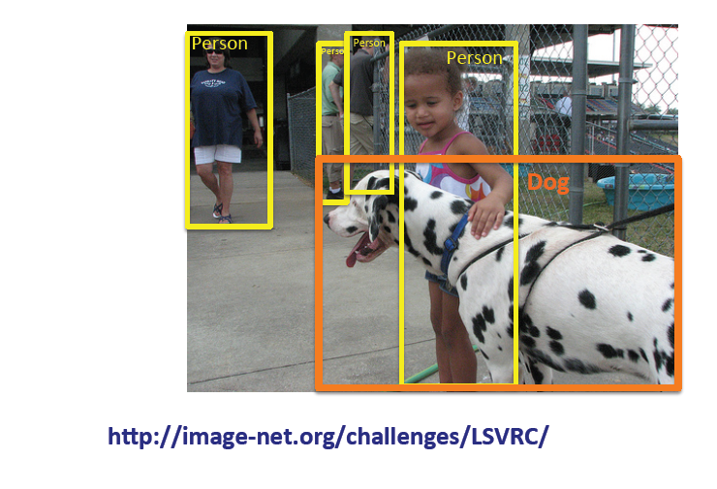
ImageNet-detection, classification & localization

Slide 11
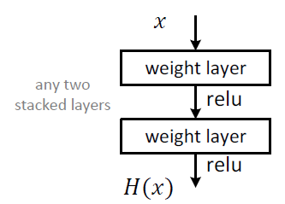
Deep residual learning
Plain net
H(x) is any desired mapping
Hope the 2 weight layers fit H(x)

Slide 12
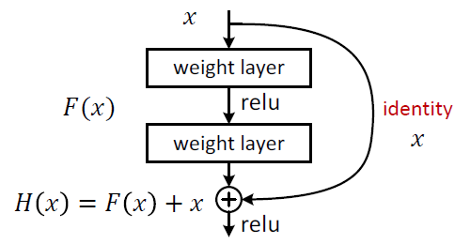
ResNet
x= input to a set of layers
H(x)=input function from input to output
F(x): Residual function
Hope the 2 weight layers fit F(x)

Slide 13
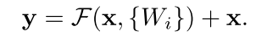
Shortcut Connection
Connections that skips one or more layers.
Identity shortcuts can be directly used when input and output are of same dimension.
X and y are input and output vectors of layers
F=W₂σ(W₁x)

Slide 14
…
If not, the shortcuts performs identity mapping with extra zero entries padded for increasing dimension.
The projection shortcut is used to match dimension:
y=F(x,{W_{i}})+W_{s}x

Slide 15
…
Shortcut connection introduce neither extra parameter nor computational complexity.
Deep residual networks are easier to optimize than their counterpart plain network.
Residual network do take care of degradation problem and give better performance than plain network.

Slide 16
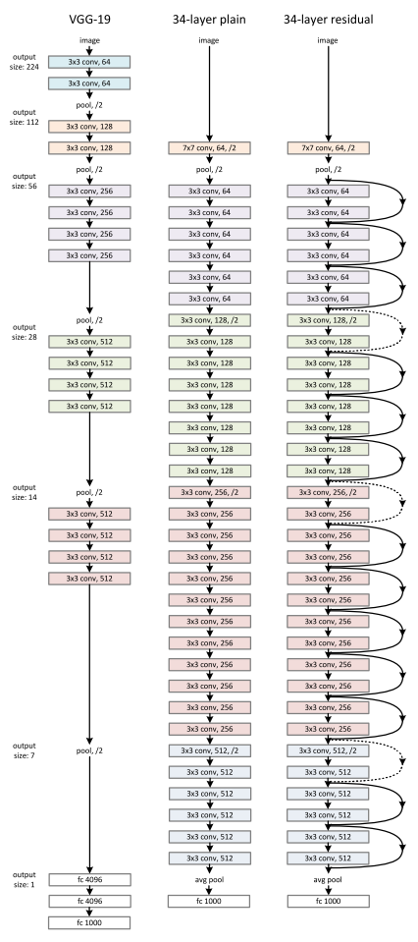
Implementation

Slide 17
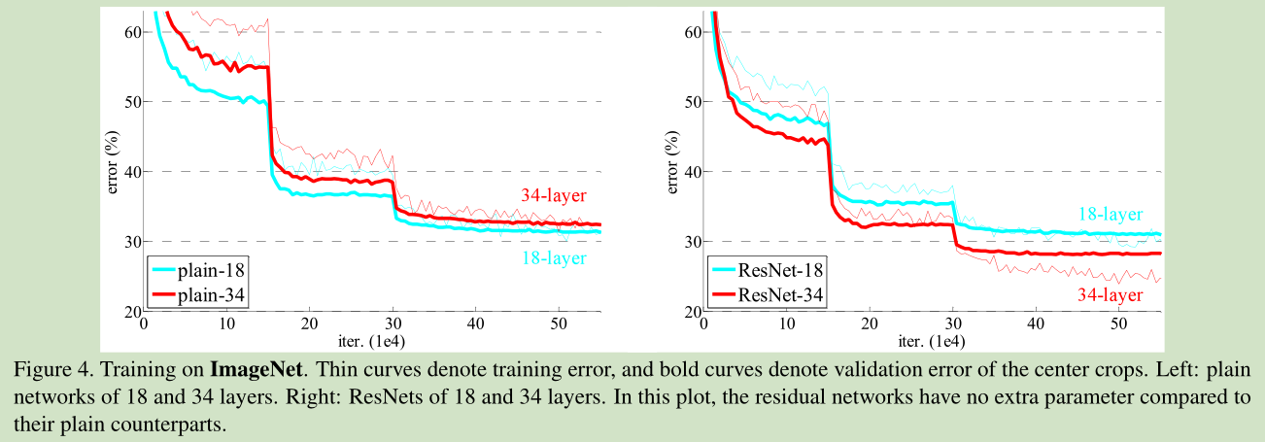
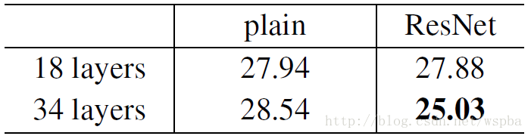

Slide 18
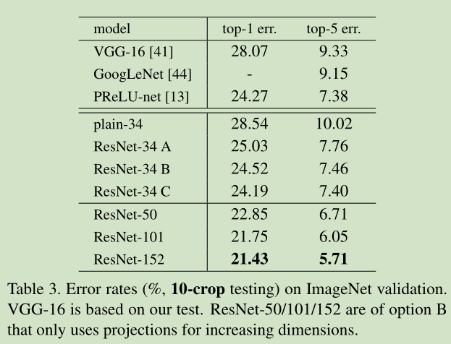

Slide 19
Three options of projection shortcut
(A) zero-padding shortcuts are used for increasing dimensions, and all shortcuts are parameter free
(B) projection shortcuts are used for increasing dimensions, and other shortcuts are identity;
(C) all shortcuts are projections.

Slide 20
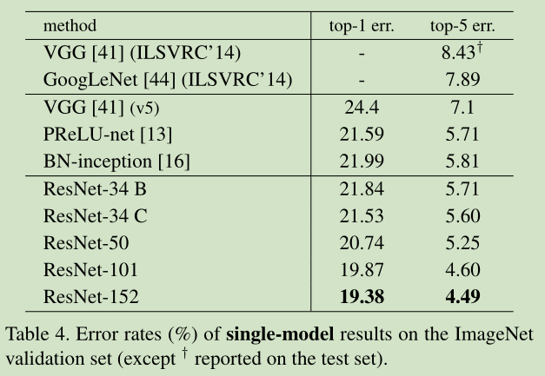

Slide 21
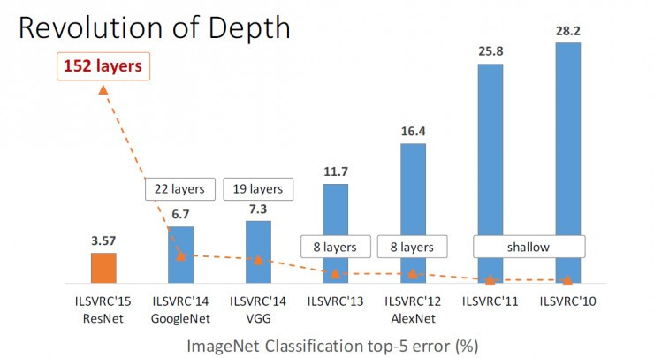

Slide 22
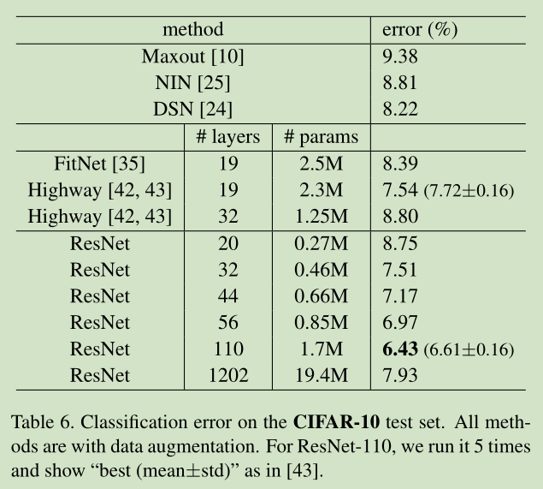

Slide 23
Exploring over 1000 layers
Test 1202 layers
Training is finished
Testing error is high because of over fitting

Slide 24
Conclusion
Deeper networks are better expectably
ResNet is very simple
We should use it from now on

Slide 25
Reference
Kaiming He, Xiangyu Zhang, Shaoqing Ren, & Jian Sun. “Deep Residual Learning for Image Recognition”. arXiv 2015.

